Slide 1



ER- and EER- Relational Mapping
CNG351 - Data Management and File Structures
Lecture - 5
Instructor: Dr. Yeliz Yesilada

Slide 2
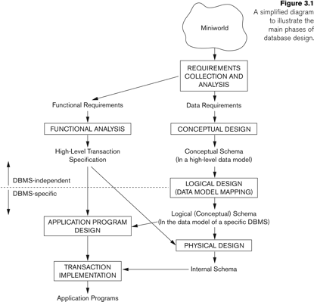
Database Design Process
Notes:
Based on this design process, this week we will focus on logical design. How to map ER and EER diagrams to relational database model.
We first start with ER mapping which includes entity types, binary relationships, attributes, etc.
We then move on to learning how to map EER diagrams, which include advance concepts like specialization/generalization and union types, etc.

Slide 3
ER & EER-to-Relational Mapping Algorithm Overview
ER-to-Relational Mapping Algorithm
Step 1: Mapping of Regular Entity Types
Step 2: Mapping of Weak Entity Types
Step 3: Mapping of Binary 1:1 Relation Types
Step 4: Mapping of Binary 1:N Relationship Types.
Step 5: Mapping of Binary M:N Relationship Types.
Step 6: Mapping of Multivalued attributes.
Step 7: Mapping of N-ary Relationship Types.
Mapping EER Model Constructs to Relations
Step 8: Options for Mapping Specialization or Generalization.
Step 9: Mapping of Union Types (Categories).

Slide 4
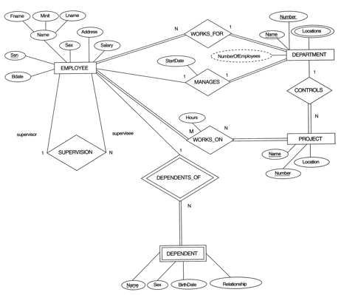
COMPANY database - ER Diagram

Slide 5
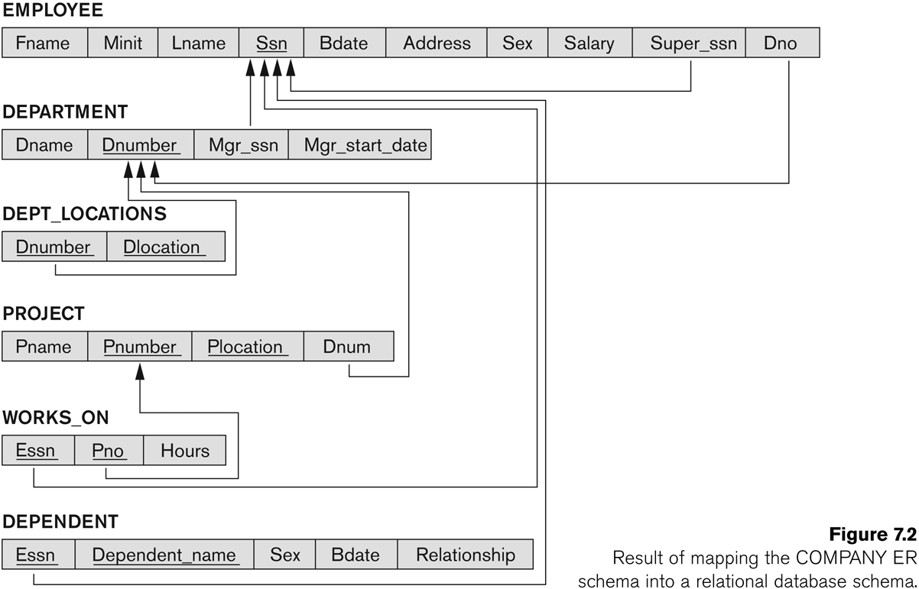
COMPANY ER into a Relational Schema

Slide 6
ER-to-Relational Mapping Algorithm
Step 1: Mapping of Regular Entity Types.
For each regular (strong) entity type E in the ER schema, create a relation R that includes all the simple attributes of E.
Choose one of the key attributes of E as the primary key for R.
If the chosen key of E is composite, the set of simple attributes that form it will together form the primary key of R.
Example: We create the relations EMPLOYEE, DEPARTMENT, and PROJECT in the relational schema corresponding to the regular entities in the ER diagram.
SSN, DNUMBER, and PNUMBER are the primary keys for the relations EMPLOYEE, DEPARTMENT, and PROJECT as shown.

Slide 7
COMPANY database - ER Diagram

Slide 8
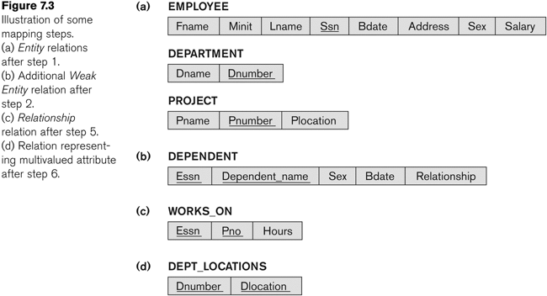
COMPANY - after Step 1

Slide 9
Step 2: Mapping Weak Entity Types
For each weak entity type W in the ER schema with owner entity type E, create a relation R & include all simple attributes (or simple components of composite attributes) of W as attributes of R.
Also, include as foreign key attributes of R the primary key attribute(s) of the relation(s) that correspond to the owner entity type(s).
The primary key of R is the combination of the primary key(s) of the owner(s) and the partial key of the weak entity type W, if any.

Slide 10
Step 2: Mapping Weak Entity Types
Example: Create the relation DEPENDENT in this step to correspond to the weak entity type DEPENDENT.
Include the primary key SSN of the EMPLOYEE relation as a foreign key attribute of DEPENDENT (renamed to ESSN).
The primary key of the DEPENDENT relation is the combination {ESSN, DEPENDENT_NAME} because DEPENDENT_NAME is the partial key of DEPENDENT.

Slide 11
COMPANY database - ER Diagram

Slide 12

COMPANY - after Step 2

Slide 13
Step 3: Mapping of Binary 1:1 Relations
For each binary 1:1 relationship type R in the ER schema, identify the relations S and T that correspond to the entity types participating in R.
There are three possible approaches:
Foreign Key approach: Choose one of the relations-say S-and include a foreign key in S the primary key of T. It is better to choose an entity type with total participation in R in the role of S.
Merged relation option: An alternate mapping of a 1:1 relationship type is possible by merging the two entity types and the relationship into a single relation. This may be appropriate when both participations are total.
Cross-reference or relationship relation option: The third alternative is to set up a third relation R for the purpose of cross-referencing the primary keys of the two relations S and T representing the entity types.

Slide 14
COMPANY ER diagram
Example: Use Option1:
1:1 relation MANAGES is mapped by choosing the participating entity type DEPARTMENT to serve in the role of S, because its participation in the MANAGES relationship type is total.

Slide 15
COMPANY database - ER Diagram

Slide 16
COMPANY - after Step 3
MgrsSSN | MgrsStartDate

Slide 17
Step 4: Mapping of 1:N Relationships
For each regular binary 1:N relationship type R, identify the relation S that represent the participating entity type at the N-side of the relationship type.
Include as foreign key in S the primary key of the relation T that represents the other entity type participating in R.
Include any simple attributes of the 1:N relation type as attributes of S.

Slide 18
Step 4: Mapping of 1:N Relationships
Example: 1:N relationship types WORKS_FOR, CONTROLS, and SUPERVISION in the figure.
For WORKS_FOR we include the primary key DNUMBER of the DEPARTMENT relation as foreign key in the EMPLOYEE relation and call it DNO.

Slide 19
COMPANY database - ER Diagram

Slide 20
COMPANY - after Step 4
DNO | SuperSSN
MgrsSSN | MgrsStartDate
DNum

Slide 21
Step 5: Mapping of N:M Relationships
For each regular binary M:N relationship type R, create a new relation S to represent R.
Include as foreign key attributes in S the primary keys of the relations that represent the participating entity types; their combination will form the primary key of S.
Also include any simple attributes of the M:N relationship type (or simple components of composite attributes) as attributes of S.

Slide 22
Step 5: Mapping of N:M Relationships
Example: The M:N relationship type WORKS_ON from the ER diagram is mapped by creating a relation WORKS_ON in the relational database schema.
The primary keys of the PROJECT and EMPLOYEE relations are included as foreign keys in WORKS_ON and renamed PNO and ESSN, respectively.
Attribute HOURS in WORKS_ON represents the HOURS attribute of the relation type. The primary key of the WORKS_ON relation is the combination of the foreign key attributes {ESSN, PNO}.

Slide 23
COMPANY database - ER Diagram

Slide 24
COMPANY - after Step 5
DNO | SuperSSN
MgrsSSN | MgrsStartDate
DNum

Slide 25
Step 6: Mapping of Multi-Valued Attributes
For each multivalued attribute A, create a new relation R.
This relation R will include an attribute corresponding to A, plus the primary key attribute K-as a foreign key in R-of the relation that represents the entity type of relationship type that has A as an attribute.
The primary key of R is the combination of A and K. If the multivalued attribute is composite, we include its simple components.

Slide 26
Step 6: Mapping of Multi-Valued Attributes
Example: The relation DEPT_LOCATIONS is created.
The attribute DLOCATION represents the multivalued attribute LOCATIONS of DEPARTMENT, while DNUMBER-as foreign key-represents the primary key of the DEPARTMENT relation.
The primary key of R is the combination of {DNUMBER, DLOCATION}.

Slide 27
COMPANY database - ER Diagram

Slide 28
COMPANY - after Step 6

Slide 29
Step 7: Mapping of N-ary Relationships
For each n-ary relationship type R, where n>2, create a new relationship S to represent R.
Include as foreign key attributes in S the primary keys of the relations that represent the participating entity types.
Also include any simple attributes of the n-ary relationship type (or simple components of composite attributes) as attributes of S.

Slide 30
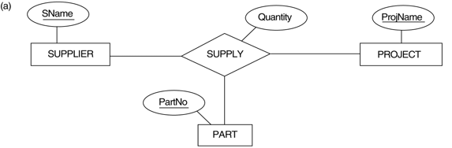
The SUPPLY relationship - Ternary

Slide 31
Step 7: Mapping of N-ary Relationships
Example: The relationship type SUPPY in the ER.
This can be mapped to the relation SUPPLY shown in the relational schema, whose primary key is the combination of the three foreign keys {SNAME, PARTNO, PROJNAME}

Slide 32
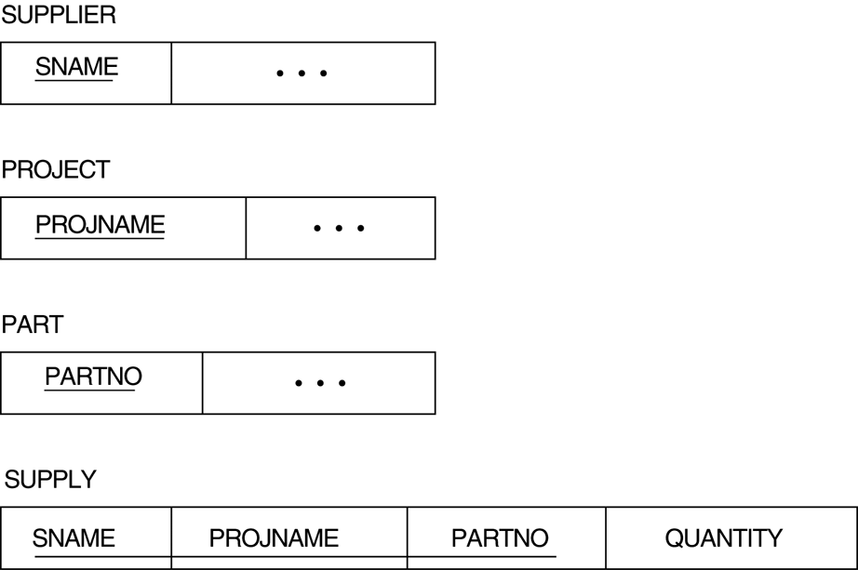
Mapping SUPPLY relationship

Slide 33
Mapping Constraints and Constructs
Table 7.1 Correspondence between ER and Relational Models
ER Model Relational Model
Entity type “Entity” relation
Weak Entity type “Entity” relation with foreign key
Identifying relationship type No need to map
1:1 or 1:N relationship type Foreign key (or “relationship” relation)
M:N relationship type “Relationship” relation and two foreign keys
n-ary relationship type “Relationship” relation and n foreign keys
Simple attribute Attribute
Composite attribute Set of simple component attributes
Multivalued attribute Relation and foreign key
Value set Domain
Key attribute Primary (or secondary) key

Slide 34
EER Mapping
Extend ER-to-Relational mapping with two more steps.
Mapping EER Model Constructs to Relations
Step 8: Options for Mapping Specialization or Generalization.
Step 9: Mapping of Union Types (Categories).

Slide 35
Step 8: Options for Mapping Specialization/Generalization
Convert each specialization with m subclasses {S1, S2,….,Sm} and generalized superclass C, where the attributes of C are {k,a1,…an} and k is the (primary) key, into relational schemas using one of the four following options:
Option 8A: Multiple relation option - Superclass and subclasses
Option 8B: Multiple relation option - Subclass relations only
Option 8C: Single relation option with one type attribute
Option 8D: Single relation option with multiple type attributes

Slide 36
Option 8A
Option 8A: Multiple relations-Superclass and subclasses
Create a relation L for C with attributes Attrs(L) = {k,a1,…an} and PK(L) = k. Create a relation Li for each subclass Si, 1 < i < m, with the attributesAttrs(Li) = {k} U {attributes of Si} and PK(Li)=k.
IMPORTANT: This option works for any specialization (total or partial, disjoint or over-lapping).

Slide 37
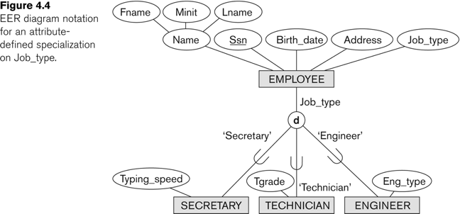
Option 8A Example

Slide 38
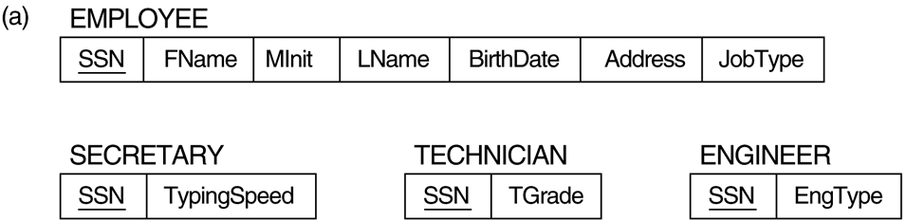
Option 8A Example

Slide 39
Option 8B
Option 8B: Multiple relations-Subclass relations only
Create a relation Li for each subclass Si, 1 < i < m, with the attributes Attr(Li) = {attributes of Si} U {k,a1…,an} and PK(Li) = k.
IMPORTANT: This option only works for a specialization whose subclasses are total (every entity in the superclass must belong to (at least) one of the subclasses).

Slide 40
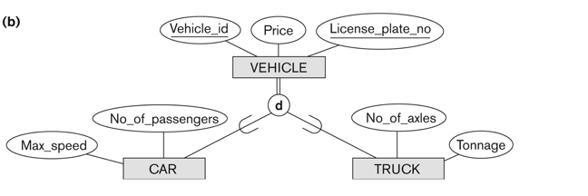
Option 8B Example

Slide 41
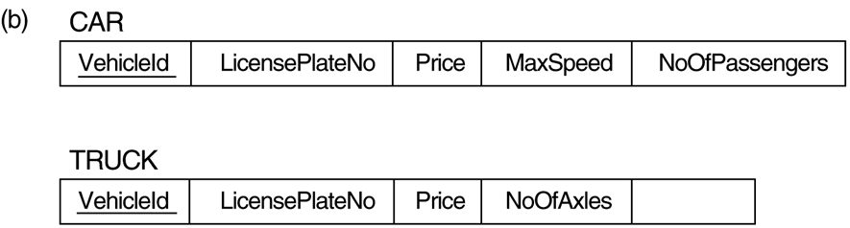
With Option 8B…
Tonnage

Slide 42
Option 8C
Option 8C: Single relation with one type attribute
Create a single relation L with attributes Attrs(L) = {k,a₁,…a_{n}} U {attributes of S₁} U…U {attributes of S_{m}} U {t} and PK(L) = k.
The attribute t is called a type (or discriminating) attribute that indicates the subclass to which each tuple belongs

Slide 43
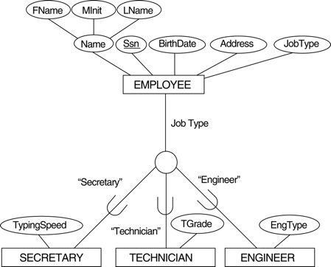
Option 8C Example

Slide 44
Option 8C Example
EngType

Slide 45
Option 8D
Option 8D: Single relation with multiple type attributes
Create a single relation schema L with attributes Attrs(L) = {k,a₁,…a_{n}} U {attributes of S₁} U…U {attributes of S_{m}} U {t₁, t₂,…,t_{m}} and PK(L) = k. Each t_{i}, 1 < I < m, is a Boolean type attribute indicating whether a tuple belongs to the subclass S_{i}.

Slide 46
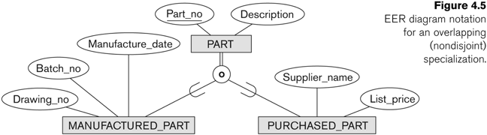
Overlapping Specialization

Slide 47
With Option 8D - Boolean type fields Mflag and Pflag

Slide 48
Mapping Multiple Inheritence
A shared subclass, such as STUDENT_ASSISTANT, is a subclass of several classes, indicating multiple inheritance. These classes must all have the same key attribute; otherwise, the shared subclass would be modeled as a category.
We can apply any of the options discussed in Step 8 to a shared subclass, subject to the restriction discussed in Step 8 of the mapping algorithm. Below both 8C and 8D are used for the shared class STUDENT_ASSISTANT.

Slide 49
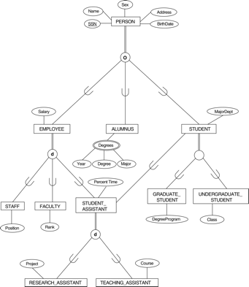
University ER - Lattice

Slide 50
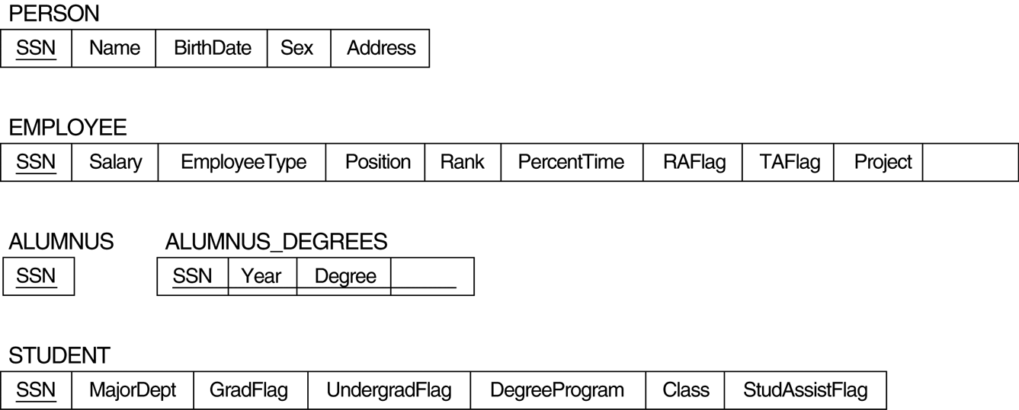
Step 1: with Option 8A
Course
Major

Slide 51
University ER - Lattice

Slide 52
Step 2: Option 8C
Course
Major

Slide 53
University ER - Lattice

Slide 54
Step 3: Option 8D
Course
Major

Slide 55
Step 9: Mapping of Union Types
For mapping a category whose defining superclass have different keys, it is customary to specify a new key attribute, called a surrogate key, when creating a relation to correspond to the category.
In the example below we can create a relation OWNER to correspond to the OWNER category and include any attributes of the category in this relation. The primary key of the OWNER relation is the surrogate key, which we called OwnerId.

Slide 56
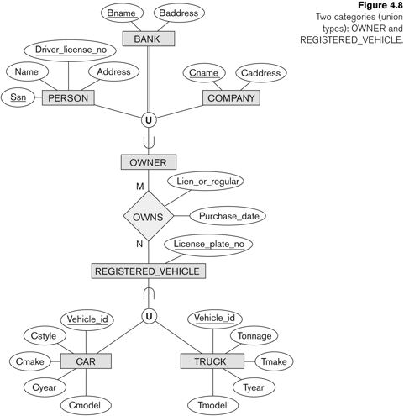
Example - Union Types

Slide 57
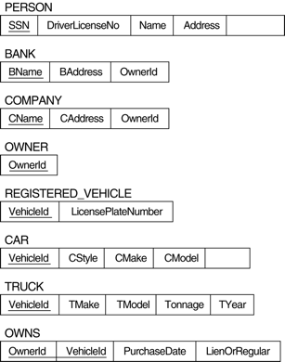
Mapping Union Types
OwnerId
CYear

Slide 58
Summary
ER-to-Relational Mapping Algorithm
Step 1: Mapping of Regular Entity Types
Step 2: Mapping of Weak Entity Types
Step 3: Mapping of Binary 1:1 Relation Types
Step 4: Mapping of Binary 1:N Relationship Types.
Step 5: Mapping of Binary M:N Relationship Types.
Step 6: Mapping of Multivalued attributes.
Step 7: Mapping of N-ary Relationship Types.
Mapping EER Model Constructs to Relations
Step 8: Options for Mapping Specialization or Generalization.
Step 9: Mapping of Union Types (Categories).

